Slide 1

AIRBNB NEW USER BOOKING PREDICTION
TEAM : Random Forest

Slide 2
Introduction
New users on Airbnb can book a place to stay in 34,000+ cities across 190+ countries. By accurately predicting where a new user will book their first travel experience, Airbnb can share more personalized content with their community, decrease the average time to first booking, and better forecast demand.

Slide 3
Workflow
1
2
3
4
5
Problem Statement
Exploratory Data Analysis
Data Cleaning
Feature Engineering
Model Training

Slide 4
Problem Statement
The problem is to predict to which country the new user of AirBnb will book his/her first travel experience.

Slide 5
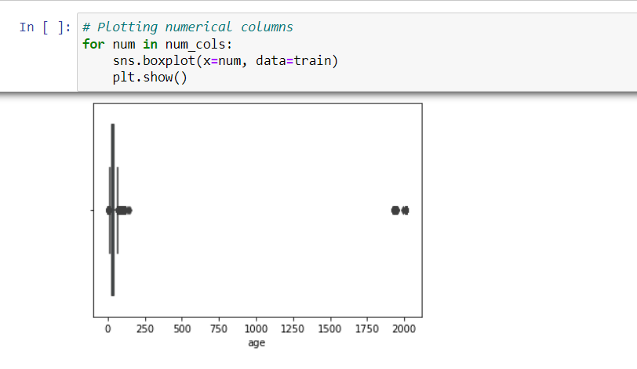
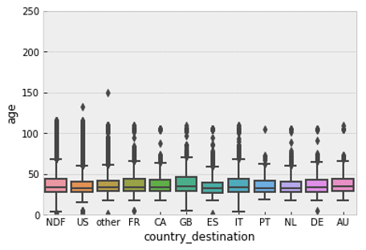
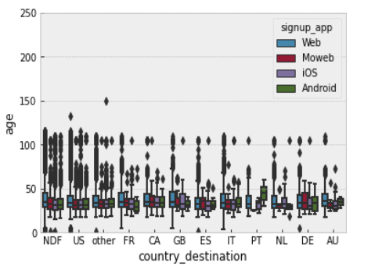
Exploratory Data Analysis
The exploratory data analysis(EDA) , after the analysis of raw data we divided the EDA into two teams one to perform univariate exploration and other to perform bivariate and multivariate analysis, to understand the variables and their relationships with each other.
From the EDA we were able to determine the trends of the user for example younger people most probably travel to the US,ES,IT and CA while older travelers turn to travel to GB,IT,AU,DE and NDF.
We were also able to determine outliers in the age variable and other important information from EDA to perform feature engineering to better train the model.

Slide 6
Data Cleaning
After the analysis of data, it was time to clean the dataset to remove unwanted categorical features for better training of the model. It was divided into steps :
Filling null values and replacing outliers with median.
Dropping the data_first_booking as the null values represent the users who did not travel.
Filling missing first_affiliate_tracked with forward fill.
Renaming id to user-id.
Our data was now processed and now can be used to train the model , but for better performance we will now perform feature engineering and encoding.

Slide 7
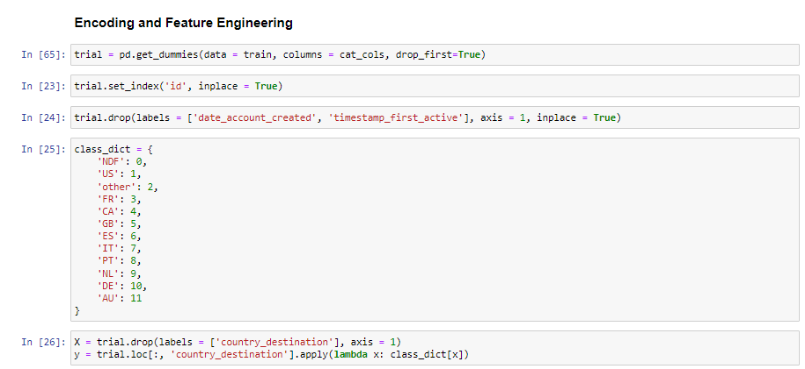
Feature Engineering & Encoding
Feature engineering is a very important step in machine learning . It means to construct artificial features into an algorithms.
Example: We dropped date_account_created and timestamp_first_active.
Encoding is a technique of converting categorical values into numerical values.
Example: We assigned numerical values to the categorical data in country_destination.

Slide 8
Model Building
After performing data cleaning and feature engineering we decided to build a baseline model we chose three classifiers :
KNN classifier
Random Forest classifier
Gradient Boosting classifier
From these three , the best result was shown by Gradient Boosting classifier that was 62.9% ndcg score . We decided to finetune this model.
We once again started from feature engineering and encoding but this time we merged both train and sessions dataset . We performed one hot encoding on the dataset and dropped redundant values.
We used GradientBoostingClassifier on the dataset now and this time the accuracy came to be 87.26%.

Slide 9
Conclusion
Working with the dataset our best model was obtained, we were able to predict the top 5 most probable destinations for each user.
Future work:
More features could have been extracted from the session data as well as train data, also other data sets like countries and age_gender_bkts can be used to build a new data set for training the model.
More hyper parameter tuning on different parameters of the model can be done.

Slide 10
Summary
We worked on the dataset of AIRBNB and we were successfully able to build a model that was able to predict where a new user of Airbnb will more likely book his flight.
We were able to build a model with an accuracy of 87.26% and we also learned on how to clean and use feature engineering on the dataset.

Slide 11
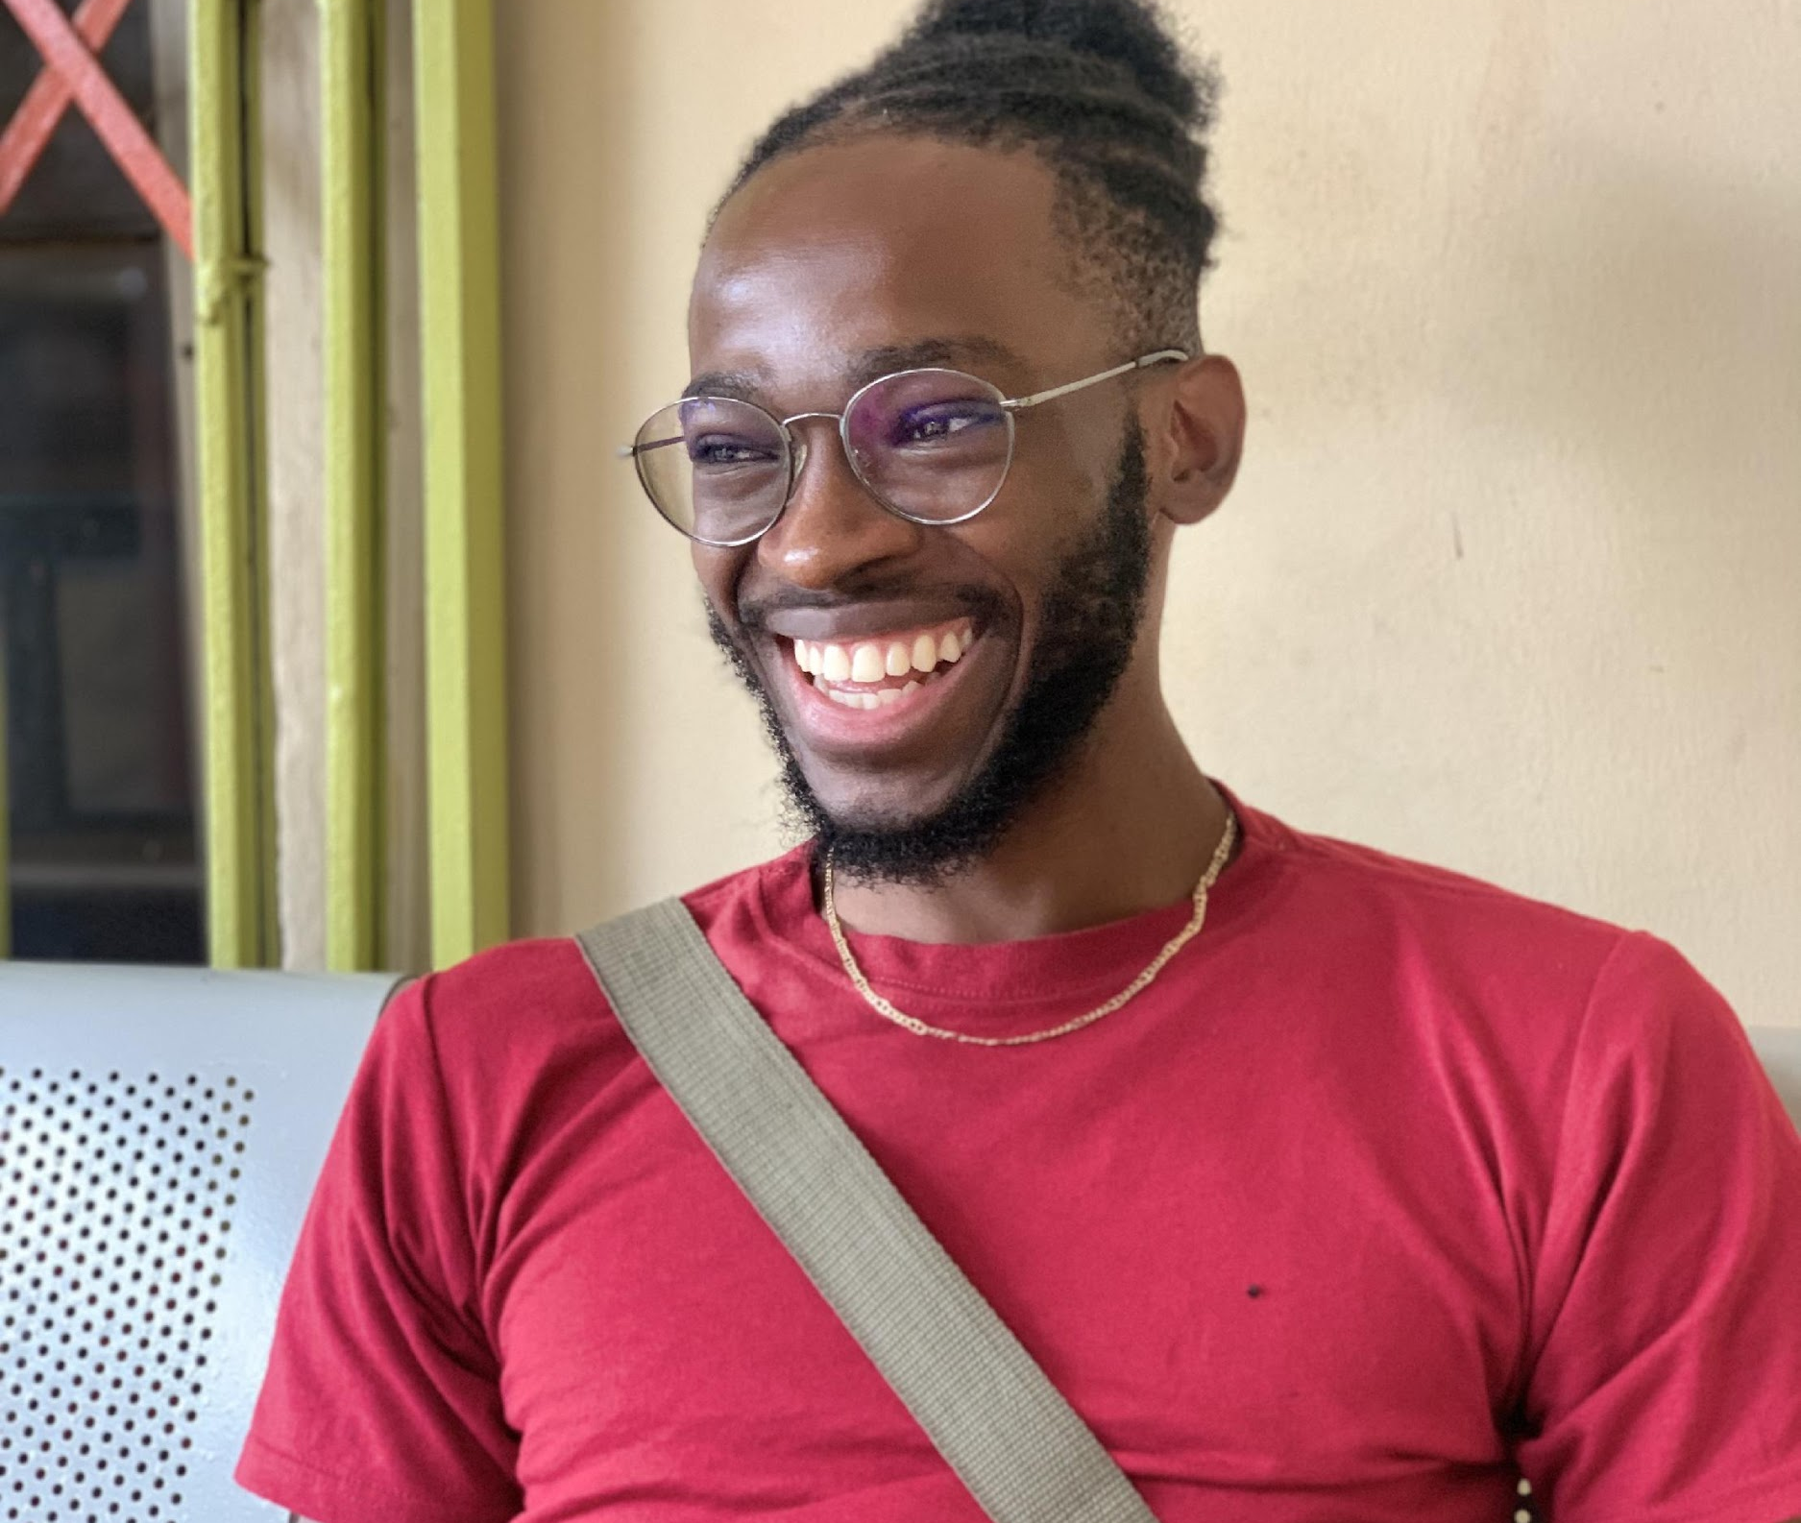

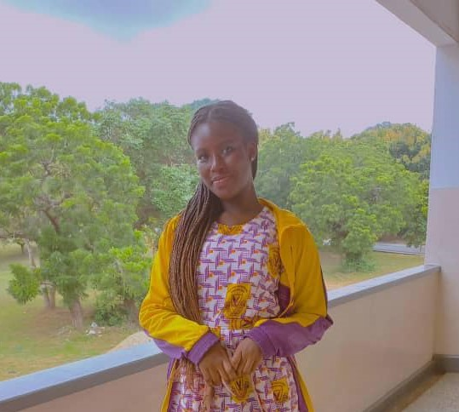
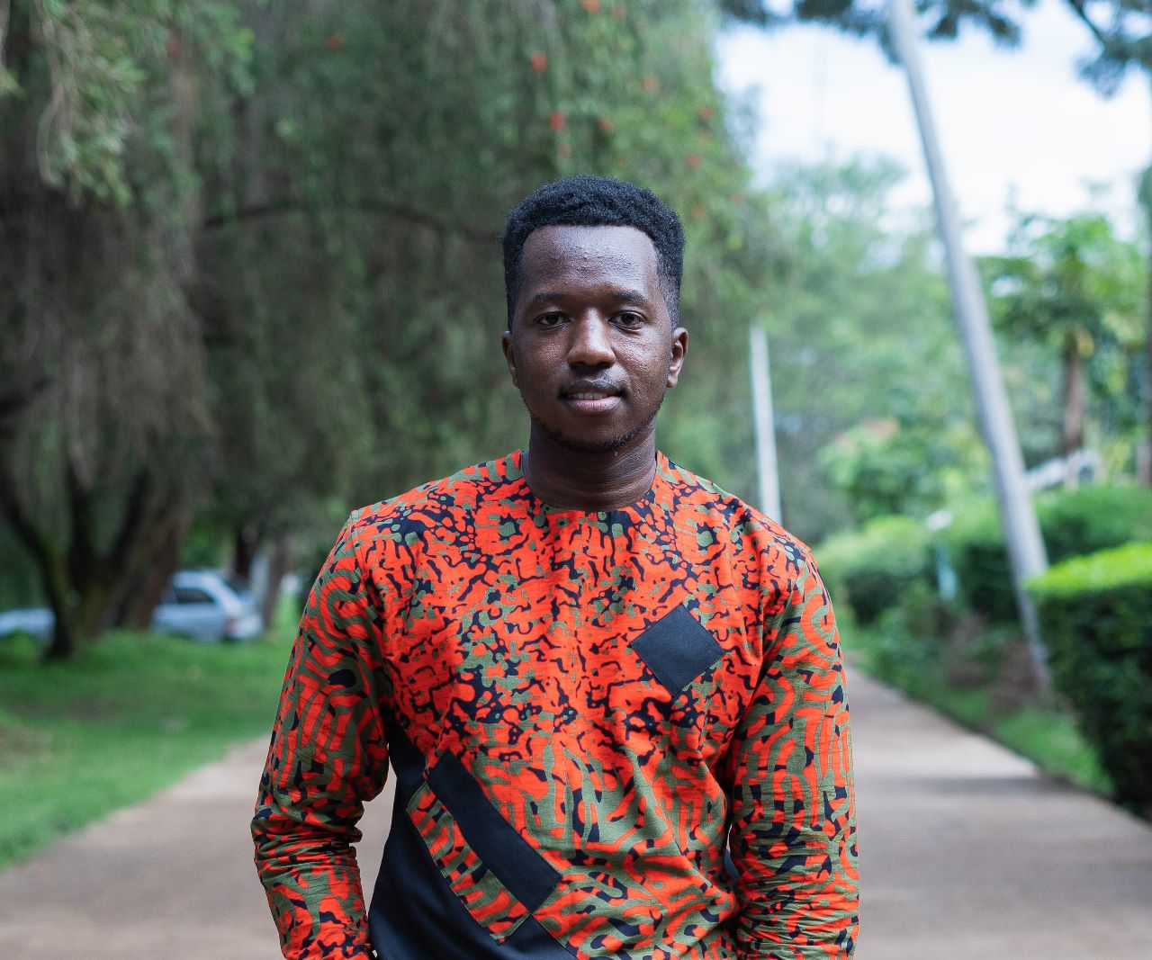
Meet part of our team
Volker Felvic Katche Tachin
Harsh Pant
Sharon Prempeh
Chris Macharia
Project Lead
Assistant Project Lead
Query Analyst Team
Data Science Team

Slide 12
Random Forest Team
Volker Felvic Katche Tachin (LEAD)
Harsh Pant (ASSISTANT PROJECT LEAD)
Peter Baba (QUERY ANALYST)
Chris Macharia
Thandazi Mnisi
Tanu Deep
Ameh Lawal
Sharon Prempeh
Gift Wilfred
Rahul TG
Isaac Baah
Elenpe Oluwakemi Deborah
Abdulrauf Taofeek Bolaji

Slide 13
Thank you
TEAM RANDOM FOREST

